Slide 1
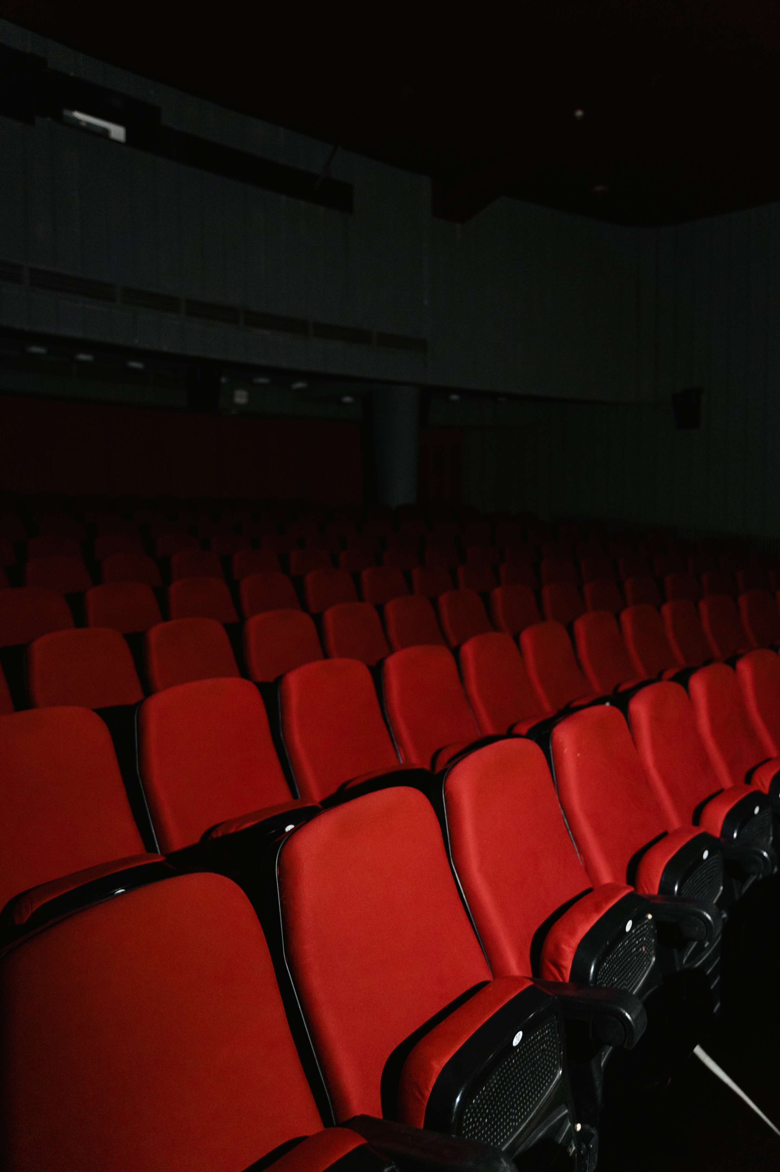
DATA 606 CAPSTONE PROJECT
NETFLIX RECOMMENDATION SYSTEM
PRESENTED BY : HARSHITHA JOSYULA
PREPARED FOR UMBC DATA SCIENCE MASTER DEGREE CAPSTONE :
DR CHAOJIE (JAY) WANG

Slide 2

TABLE OF CONTENTS
- Problem Statement
Dataset Overview
Exploratory Data Analysis
- Methodology
- Hybrid Model Architecture
- Results
- System Demonstration
- Conclusion

Slide 3
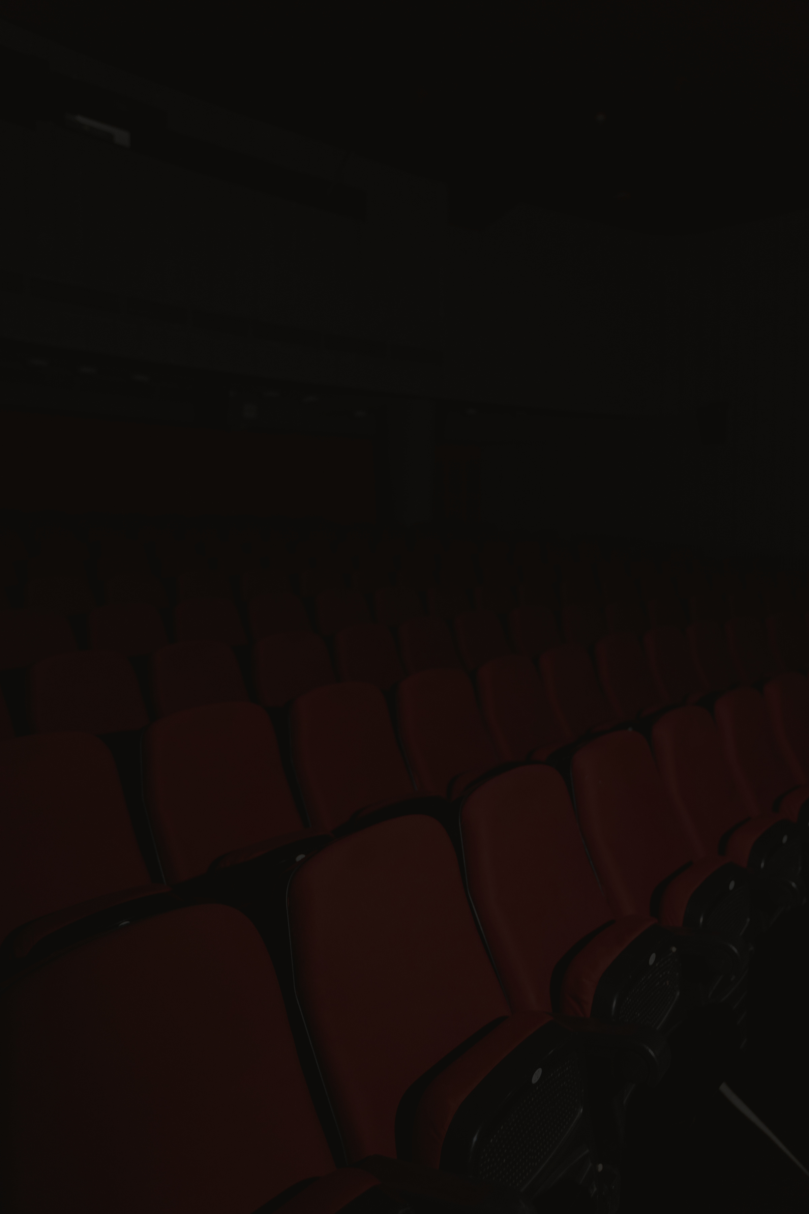
PROBLEM STATEMENT
8,800+ TITLES CREATE CHOICE PARALYSIS
USERS SPEND MORE TIME SEARCHING THAN WATCHING
80% OF CONTENT DISCOVERED THROUGH RECOMMENDATIONS
NEED: INTELLIGENT RECOMMENDATION ENGINE

Slide 4

PROJECT OBJECTIVES
DEVELOP CONTENT-BASED RECOMMENDATION SYSTEM
ACHIEVE >50% AVERAGE SIMILARITY ACCURACY
CREATE INTERACTIVE, DEPLOYED APPLICATION
PROVIDES EXPLAINABLE RECOMMENDATIONS BASED ON CONTENT FEATURES
HANDLES BOTH MOVIES AND TV SHOWS UNIFORMLY
SCALES EFFICIENTLY TO CATALOGS OF 5,000+ TITLES

Slide 5
DATASET
2.DATA CHARACTERISTICS:
File Size: 2.5 MB (CSV format)
Records: 8,807 unique titles
Features: 12 attributes per title
Temporal Coverage: Content from 1920s to 2021
Geographic Scope: Global content from 100+ countries
Content Types: Movies (69.6%) and TV Shows (30.4%)
1.DATA SOURCE AND ACQUISITION
Dataset: Netflix Movies and TV Shows
Source: Publicly available aggregated Netflix catalog data
Accessibility: Open-source dataset hosted on public repositories

Slide 6
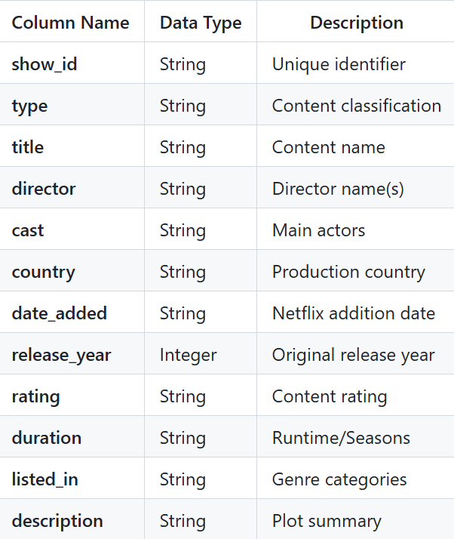

DATA FEATURES

Slide 7
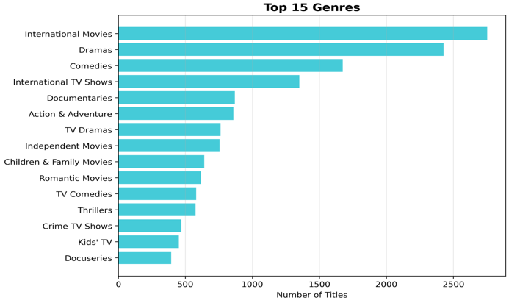
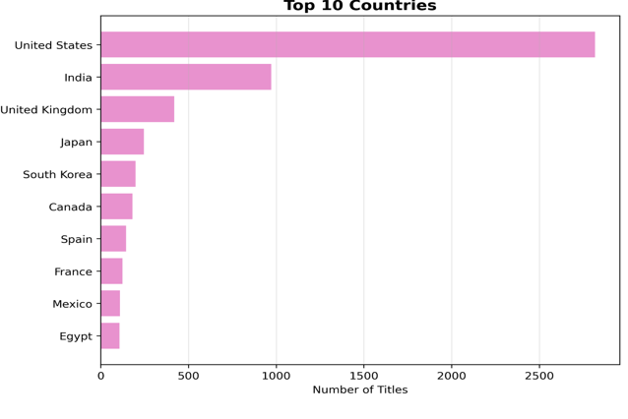
EXPLORATORY DATA ANALYSIS

Slide 8
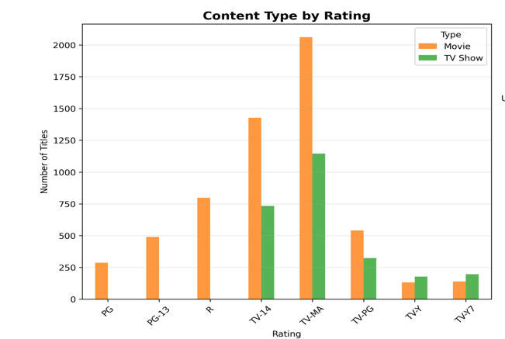
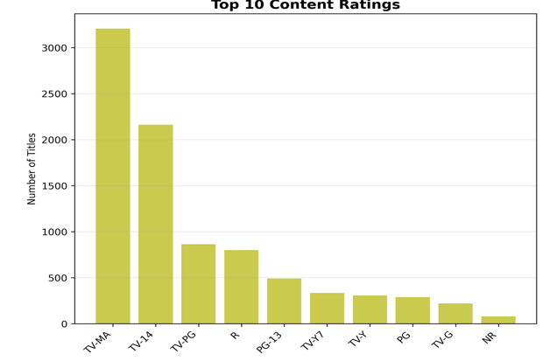
EXPLORATORY DATA ANALYSIS

Slide 9
METHODOLOGY
CONTENT-BASED FILTERING APPROACH:
-Analyzes features rather than user behavior
- recommends similar items based on content attributes
- Works without user interaction history
Hybrid Machine Learning Model:
- Combines 6 independent similarity signals
- Genre, Director, Cast, Description,Type, Rating
- Weighted ensemble approach
Why does the Hybrid Approach work?
- Captures multiple dimensions of similarity
- More accurate than single-method systems
- Mimics how humans evaluate content similarity

Slide 10


TECHNICAL IMPLEMENTATION
TECHNOLOGY STACK
PROGRAMMING: PYTHON
ML LIBRARIES: SCIKIT-LEarn, NumPy, Pandas
Text Processing: TF-IDF Vectorization
Similarity Metrics: Cosine & Jaccard Similarity
Deployment: Streamlit Web Framework

Slide 11

MODEL PROCESS FLOW
Extract Features
(6 dimensions)
Calculate Similarity Scores
Return Top Recommendations
User Selects Title
Rank Results
Apply Weights

Slide 12

RESULTS
Average Similarity Score: 65.2%
Quality Distribution:
- Excellent (≥80%): 22.3%
Great (60-79%): 30.5%
- Good (40-59%): 28.5%
- Poor (<40%): 18.7%
Overall: 81% Good or Better

Slide 13
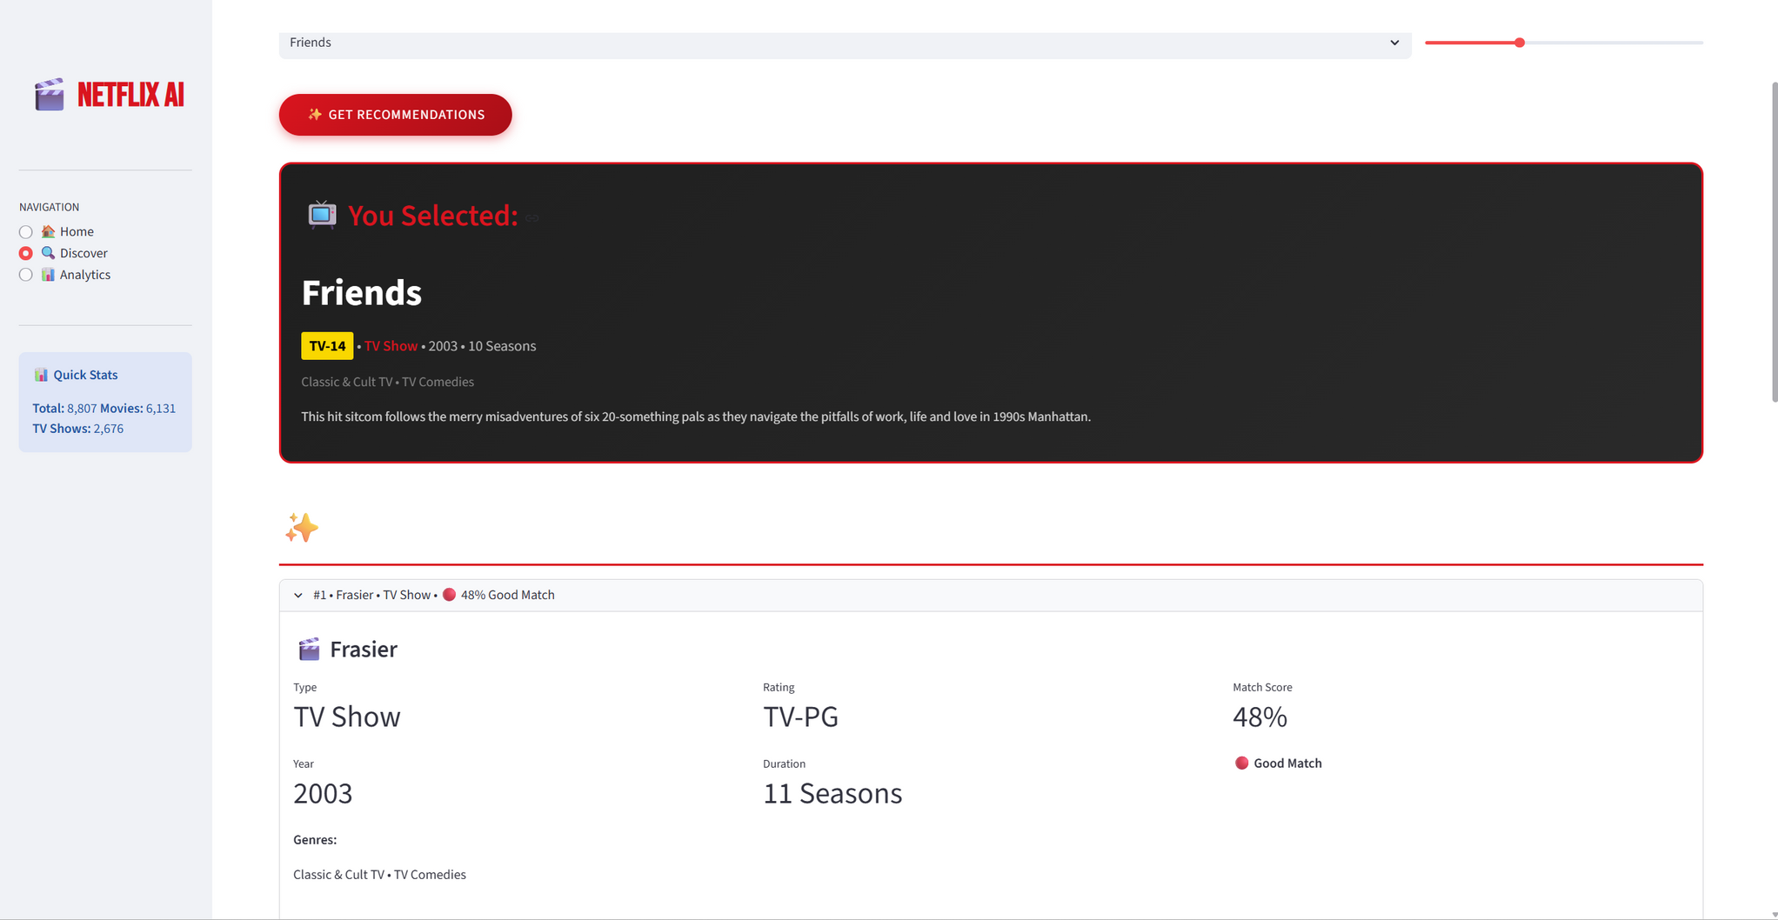
SYSTEM DEMONSTRATION

Slide 14
CONCLUSION
Key Learnings
- Machine learning requires iterative problem-solving
- Feature engineering is more critical than algorithms
- Real-world applications need multiple perspectives
- Deployment transforms research into practical tools
Skills Demonstrated
- End-to-end ML project execution
- Data processing and feature engineering
- Model development and evaluation
- System deployment and presentation
Industry Relevance
Recommendation systems are fundamental to modern
digital platforms - streaming services, e-commerce,
social media, and content discovery

Slide 15
FUTURE WORK
Improvements:
Add user behavior data (collaborative filtering)
Implement deep learning for embeddings
Enable personalized weights
Add real-time trending factors
Next Steps:
Scale to larger catalogs and integrate user feedback
Notes:
"Looking ahead, there are several exciting directions for future work."
[Point to improvements]
"If I had access to user behavior data, I could add collaborative filtering - combining content-based and user-based approaches."
"Deep learning could create better text embeddings."
"Personalized weights would let each user tune the system to their preferences."
[Pause]
[Point to next steps]
"The immediate next steps would be scaling to larger catalogs and integrating real user feedback to continue improving the model."

Slide 16
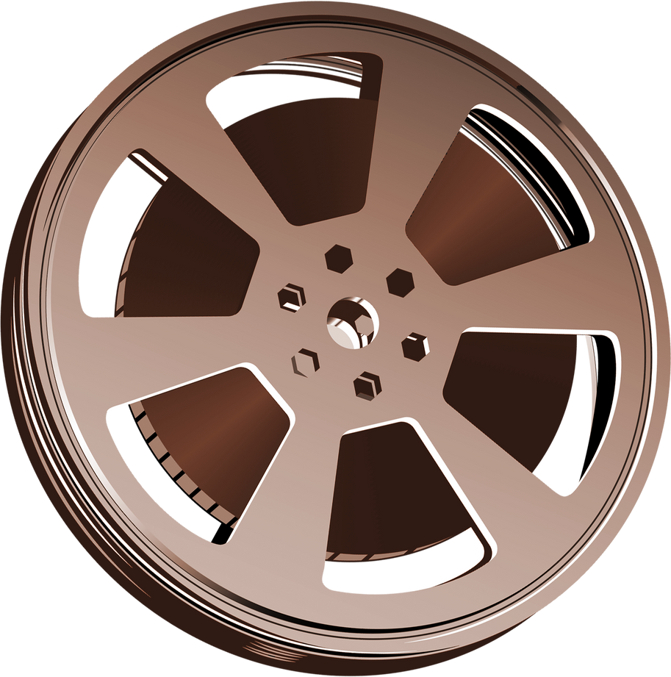

THANKYOU !

